Slide 1
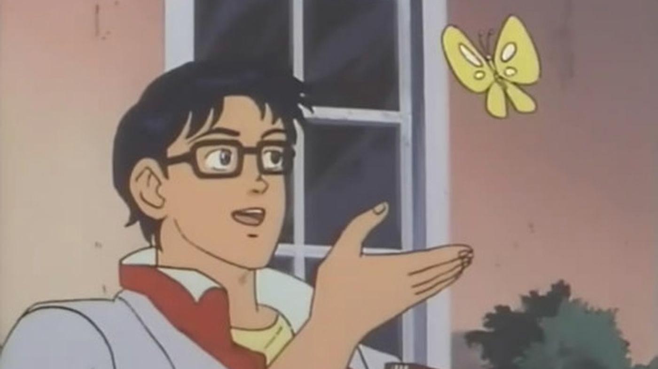
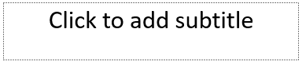
Let’s Create Animated Memes Using Python MoviePy

Slide 2
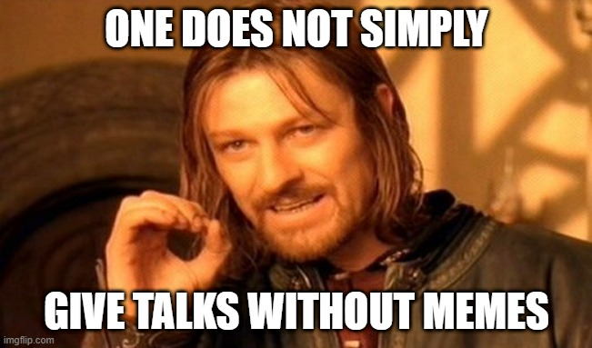
What is this brown bag talk about?
Python Programming Language
Using Python to edit a movie meme clip
How to download a video from youtube for the meme
Files will be uploaded to github during the talk
You can follow along
https://github.com/pythonph/PythonHour

Slide 3
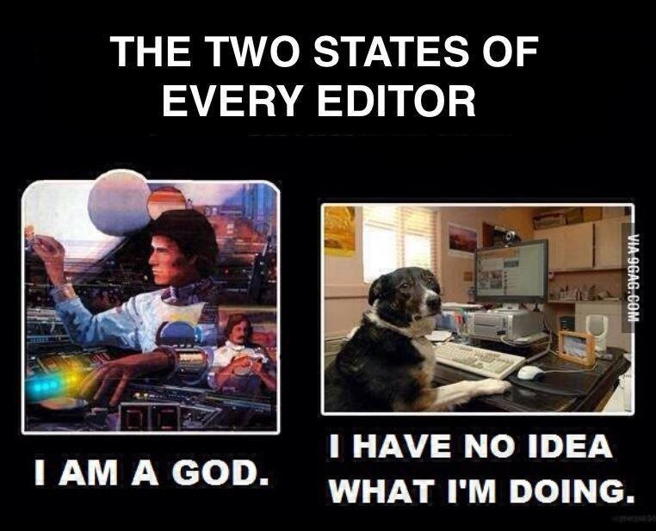
Introducing MoviePy
https://zulko.github.io/moviepy/
Use pip to download the library
$ pip install moviepy
MoviePy is a Python module for video editing
It allows for video operations like video compositing, video processing, or to create advanced effects.
It can read and write the most common video formats, including GIF.

Slide 4
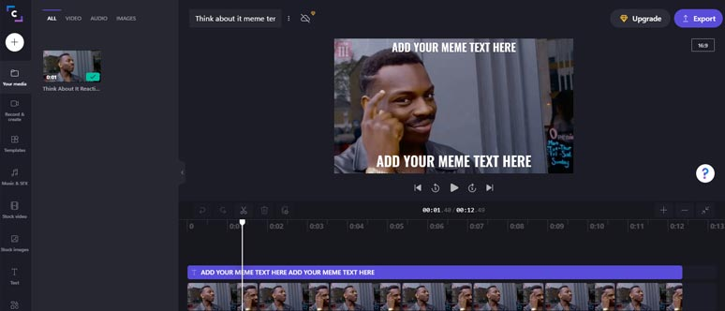
The basics of moviepy
VideoFileClips
subclip
write_videofile
Sample code

Slide 5
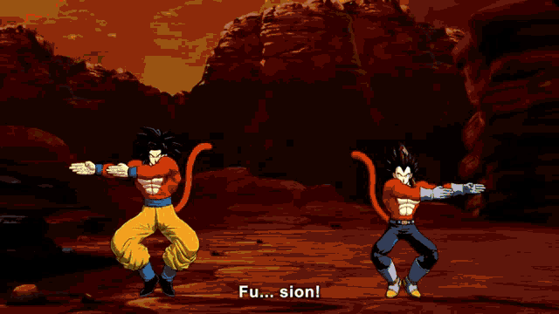
The basics of moviepy
VideoFileClips
concatenate_videoclips
Sample code

Slide 6
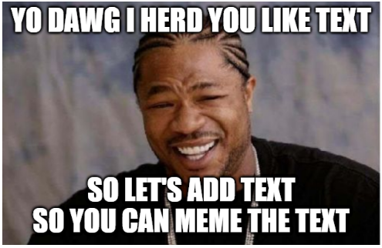
The basics of moviepy
VideoFileClips
write_gif
TextClip
ImageClip
CompositeVideoClip
Sample code

Slide 7

Introducing youtube-dl
https://youtube-dl.org/
Download the executable from the website or use pip to download the library
$ pip install youtube-dl
youtube-dl is a command-line program to download videos from YouTube.com and a few more sites
Example:
https://www.youtube.com/watch?v=hgI0p1zf31k
$ youtube-dl https://www.youtube.com/watch?v=hgI0p1zf31k
$ youtube-dl https://www.youtube.com/watch?v=hgI0p1zf31k -F
$ youtube-dl https://www.youtube.com/watch?v=hgI0p1zf31k -f 160+140 -o "pep8 song.mp4"

Slide 8
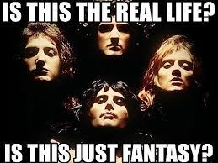
Moviepy fx features
margin
vfx.mirror_x
vfx.mirror_y
resize
Sample code

Slide 9
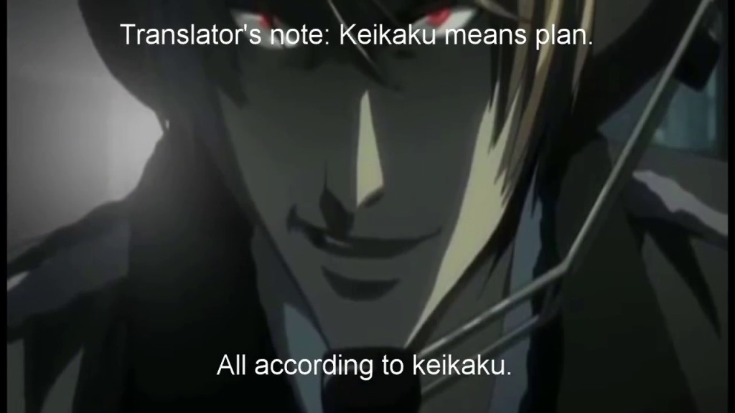
Introduction to Substitles file format
There is a standard format for subtitles
Contains text on when a subtitle should appear
Youtube and subbed anime uses this format
$ youtube-dl https://www.youtube.com/watch?v=hgI0p1zf31k --write-sub

Slide 10
Moviepy and Subtitles
SubtitlesClip
Uses .srt format
Sample Karaoke video
https://www.youtube.com/watch?v=dQw4w9WgXcQ
$ youtube-dl https://www.youtube.com/watch?v=dQw4w9WgXcQ -o song.mp4
Sample code

Slide 11
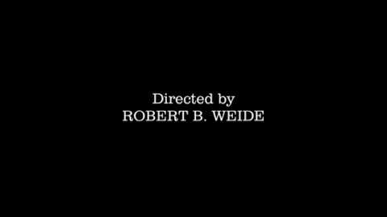
Wakas

